Slide 1
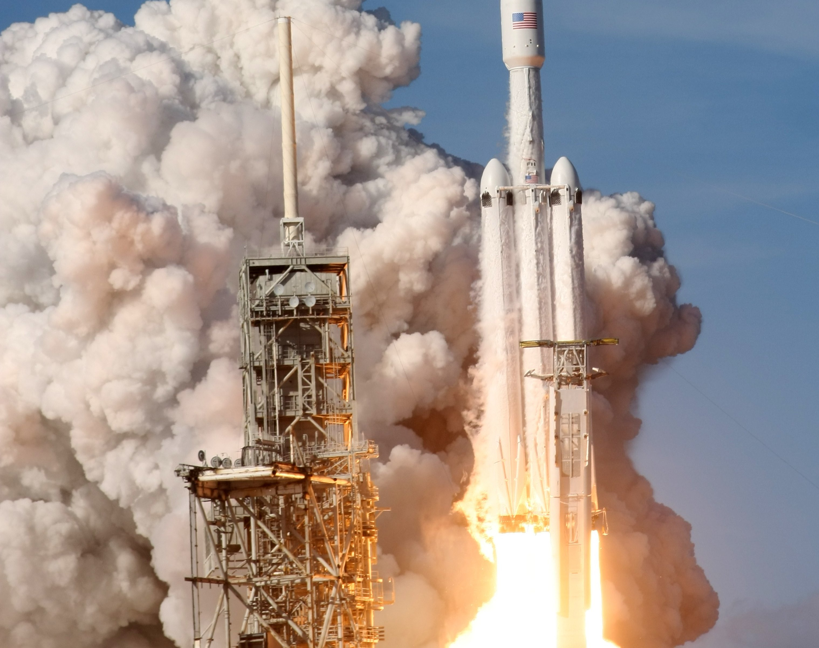
Wining the Space Race With Data Science
Gregory L. Gunther
IBM Data Science Professional Certification Capstone
2025

Slide 2
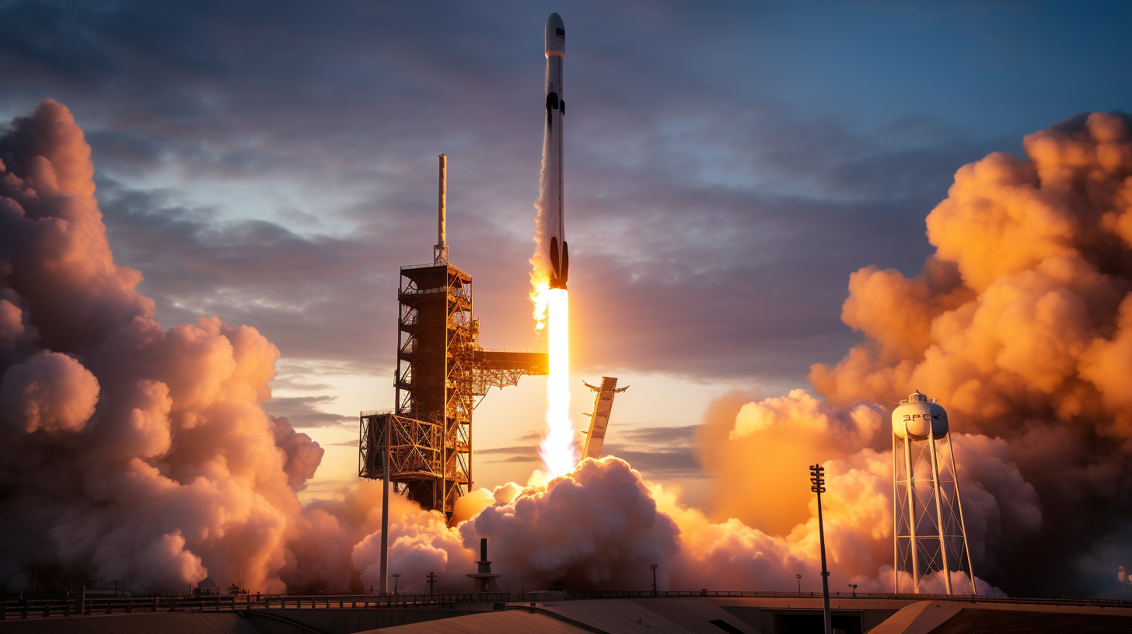
Outline
Executive Summary
Introduction
Methodology
Results
Conclusion
Appendix
N E X T

Slide 3

1.
Results suggestion launches have a correlation with the outcome of the launches
Executive Summary
2.
Decision Tree is the best machine learning algorithm to predict if the Falcon 9 first stage will land successfully.
N E X T
3.
Srd Executive Summary Element

Slide 4


Introduction
Project Overview
Analyze SpaceX Falcon 9 rocket landing success patterns using machine learning techniques.
Business Problem
Predict first stage landing success to determine launch costs and competitive bidding strategies against SpaceX.
The Challenge
SpaceX Falcon 9: $62M per launch
Other providers: $165M+ per launch
Cost advantage from first stage reusability
Need to predict landing success for competitive analysis
Project Goal
Develop a machine learning model to predict whether the Falcon 9 first stage will land successfully, enabling accurate cost estimation for competitive bidding.
Success Criteria
Create accurate predictive models using data science methodology including data collection, wrangling, exploratory analysis, visualization, and machine learning model development.
N E X T

Slide 5


Slide 6
Data Collection
Data Wrangling
Exploratory Data Analysis
Visualization
Modeling
Evaluation
API Access and Web Scraping
Cleaning and Processing
Exploration
Infographics Interactive Dashboards
Algorithm Development
Results and Insights
Methodology
N E X T

Slide 7
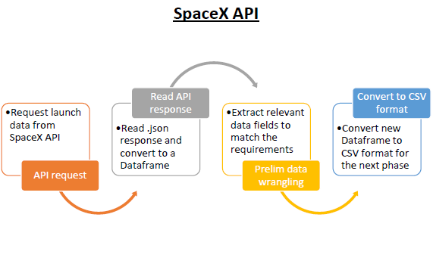
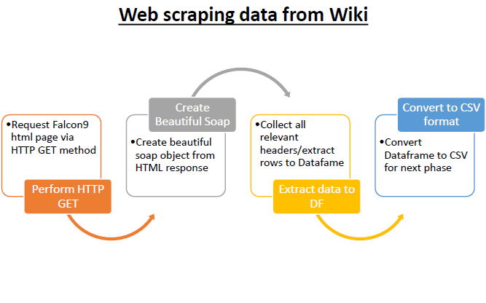
Data Collection
SpaceX REST API
Historical launch data (2010-2020)
Rocket specifications & configurations
Mission details & outcomes
Landing success/failure records
Launch site information
Web Scraping (Wikipedia)
Falcon 9 launch history tables
Mission payload information
Orbit type classifications
Launch site details
Additional mission context
N E X T
Graphic Source: IBM-AppliedDataScience-Capstone-FINAL/FINAL FINDINGS_IBM-DataScience-Professional-Cert_Applied_Capstone_Project.pdf at master · vikthak/IBM-AppliedDataScience-Capstone-FINAL · GitHub

Slide 8

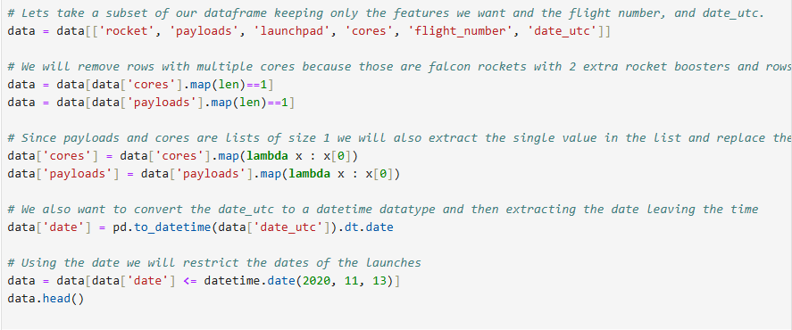

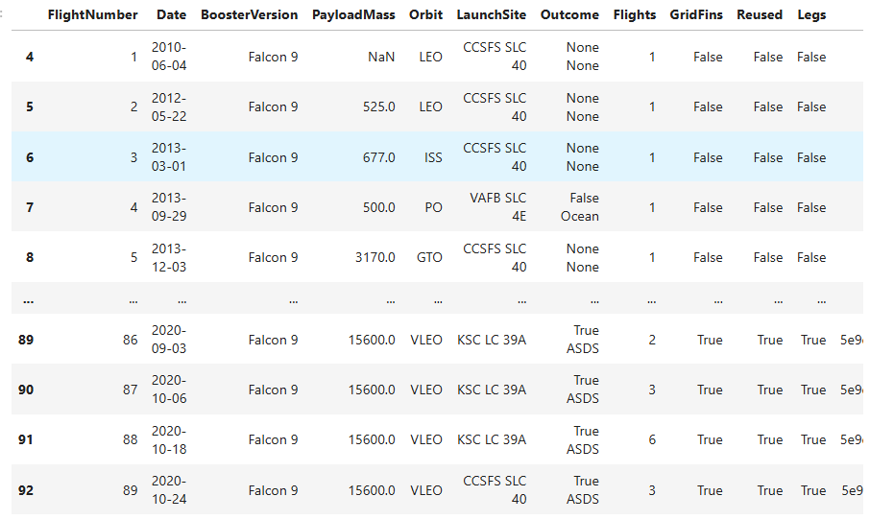
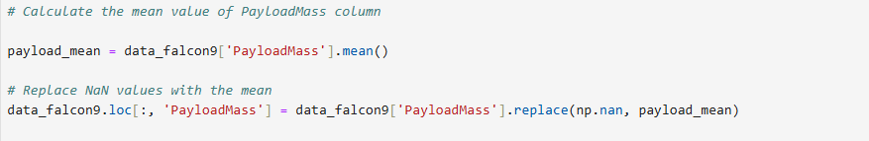
Data Collection Using SpaceX API
My Skills
The Good Stuff!
N E X T
Notebook
Output Dataset
Output
Cleaning Things Up!

Slide 9
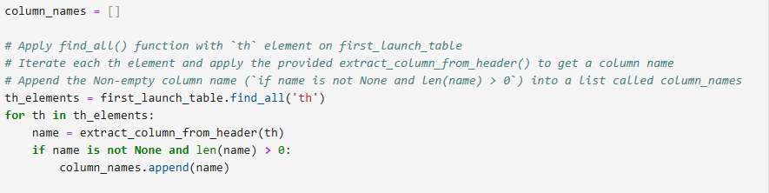
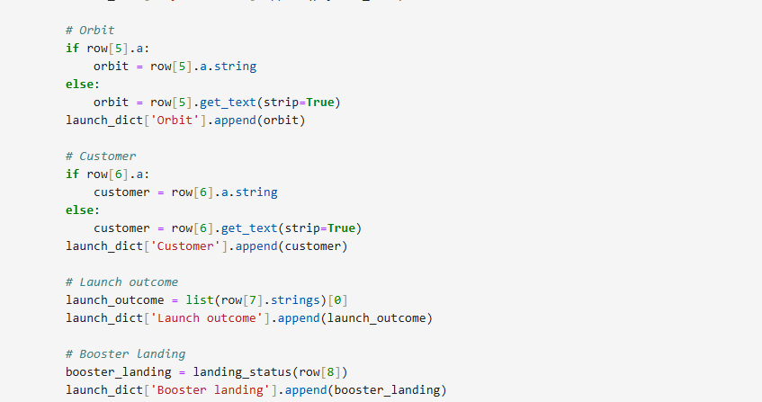
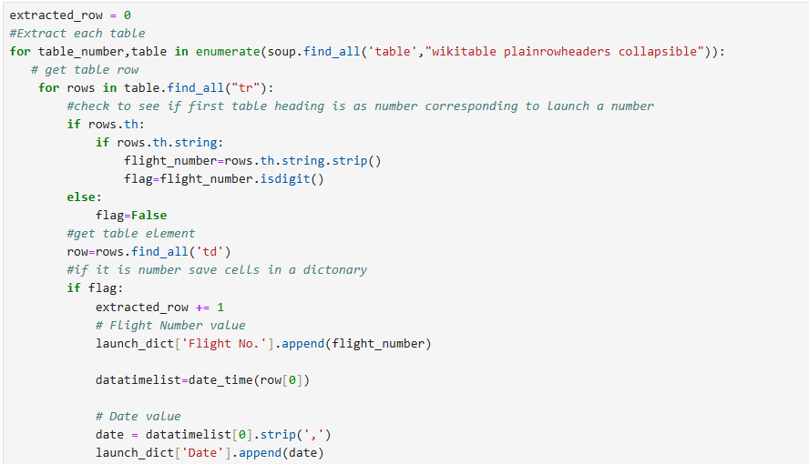
Web Scraping
My Skills
The Good Stuff!
N E X T
Parsing
Notebook
Output Dataset

Slide 10
Data Wrangling
Notebook
Output Dataset
Data Quality Assessment
Analyzed SpaceX Falcon 9 dataset with 90+ launch records, identifying that only
LandingPad had missing values (28.9% missing data)
Launch Site Analysis
Discovered CCAFS SLC 40 had the most launches (55), followed by KSC LC 39A (22) and VAFB SLC 4E (13), with GTO being the most common orbit type (27 missions)
Binary Classification Labels
Created training labels by converting mission outcomes into binary format - successful landings (True Ocean, True RTLS, True ASDS) = 1, unsuccessful landings (False outcomes and None outcomes) = 0
Success Rate Calculation
Determined overall landing success rate of 66.7% across all missions, providing baseline performance metric for predictive modeling
Dataset Preparation
Exported cleaned and labeled dataset for machine learning model development, with all features properly categorized as numerical or categorical variables
N E X T

Slide 11
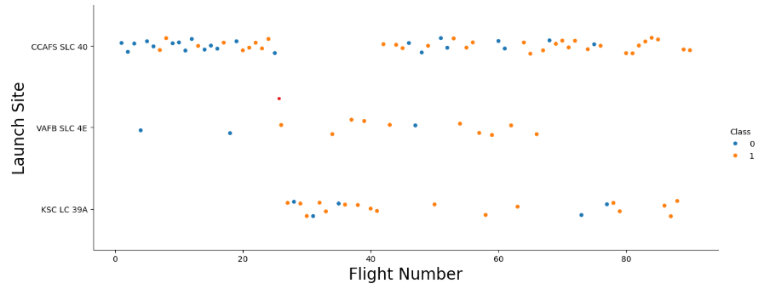
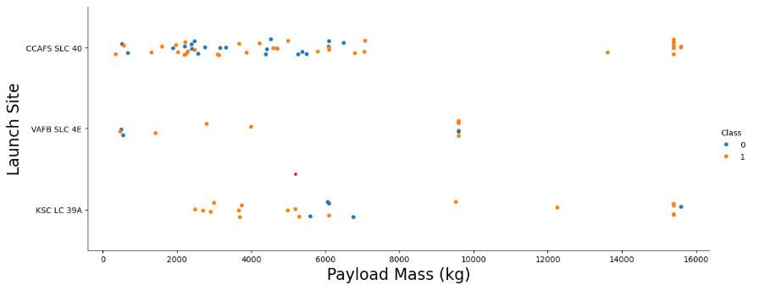
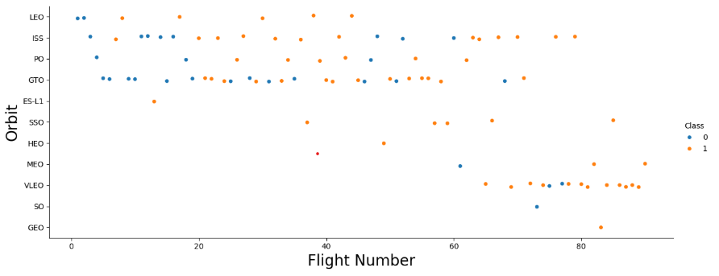
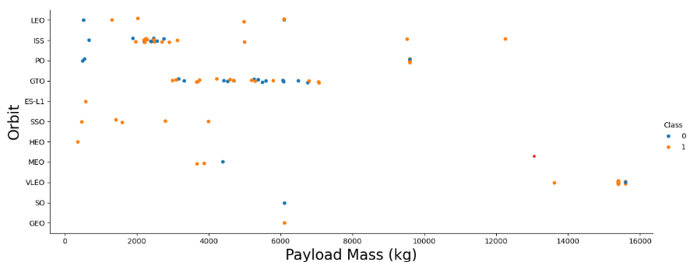
Visualization
N E X T

Slide 12
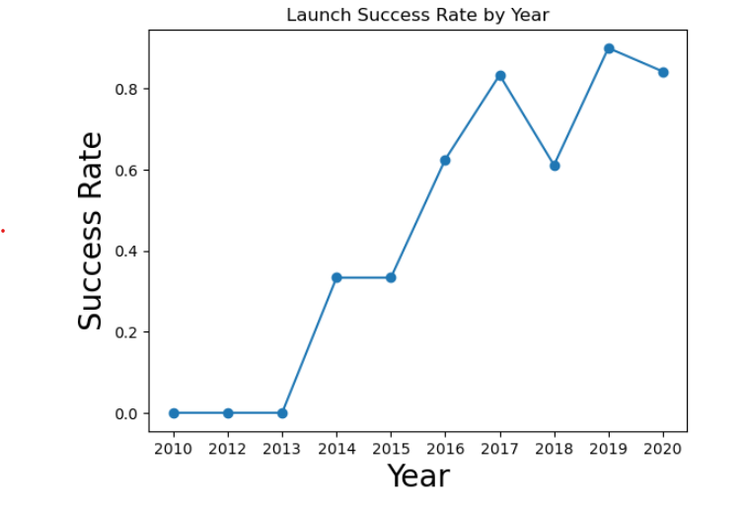
Visualization
Notebook
Output Dataset
N E X T

Slide 13
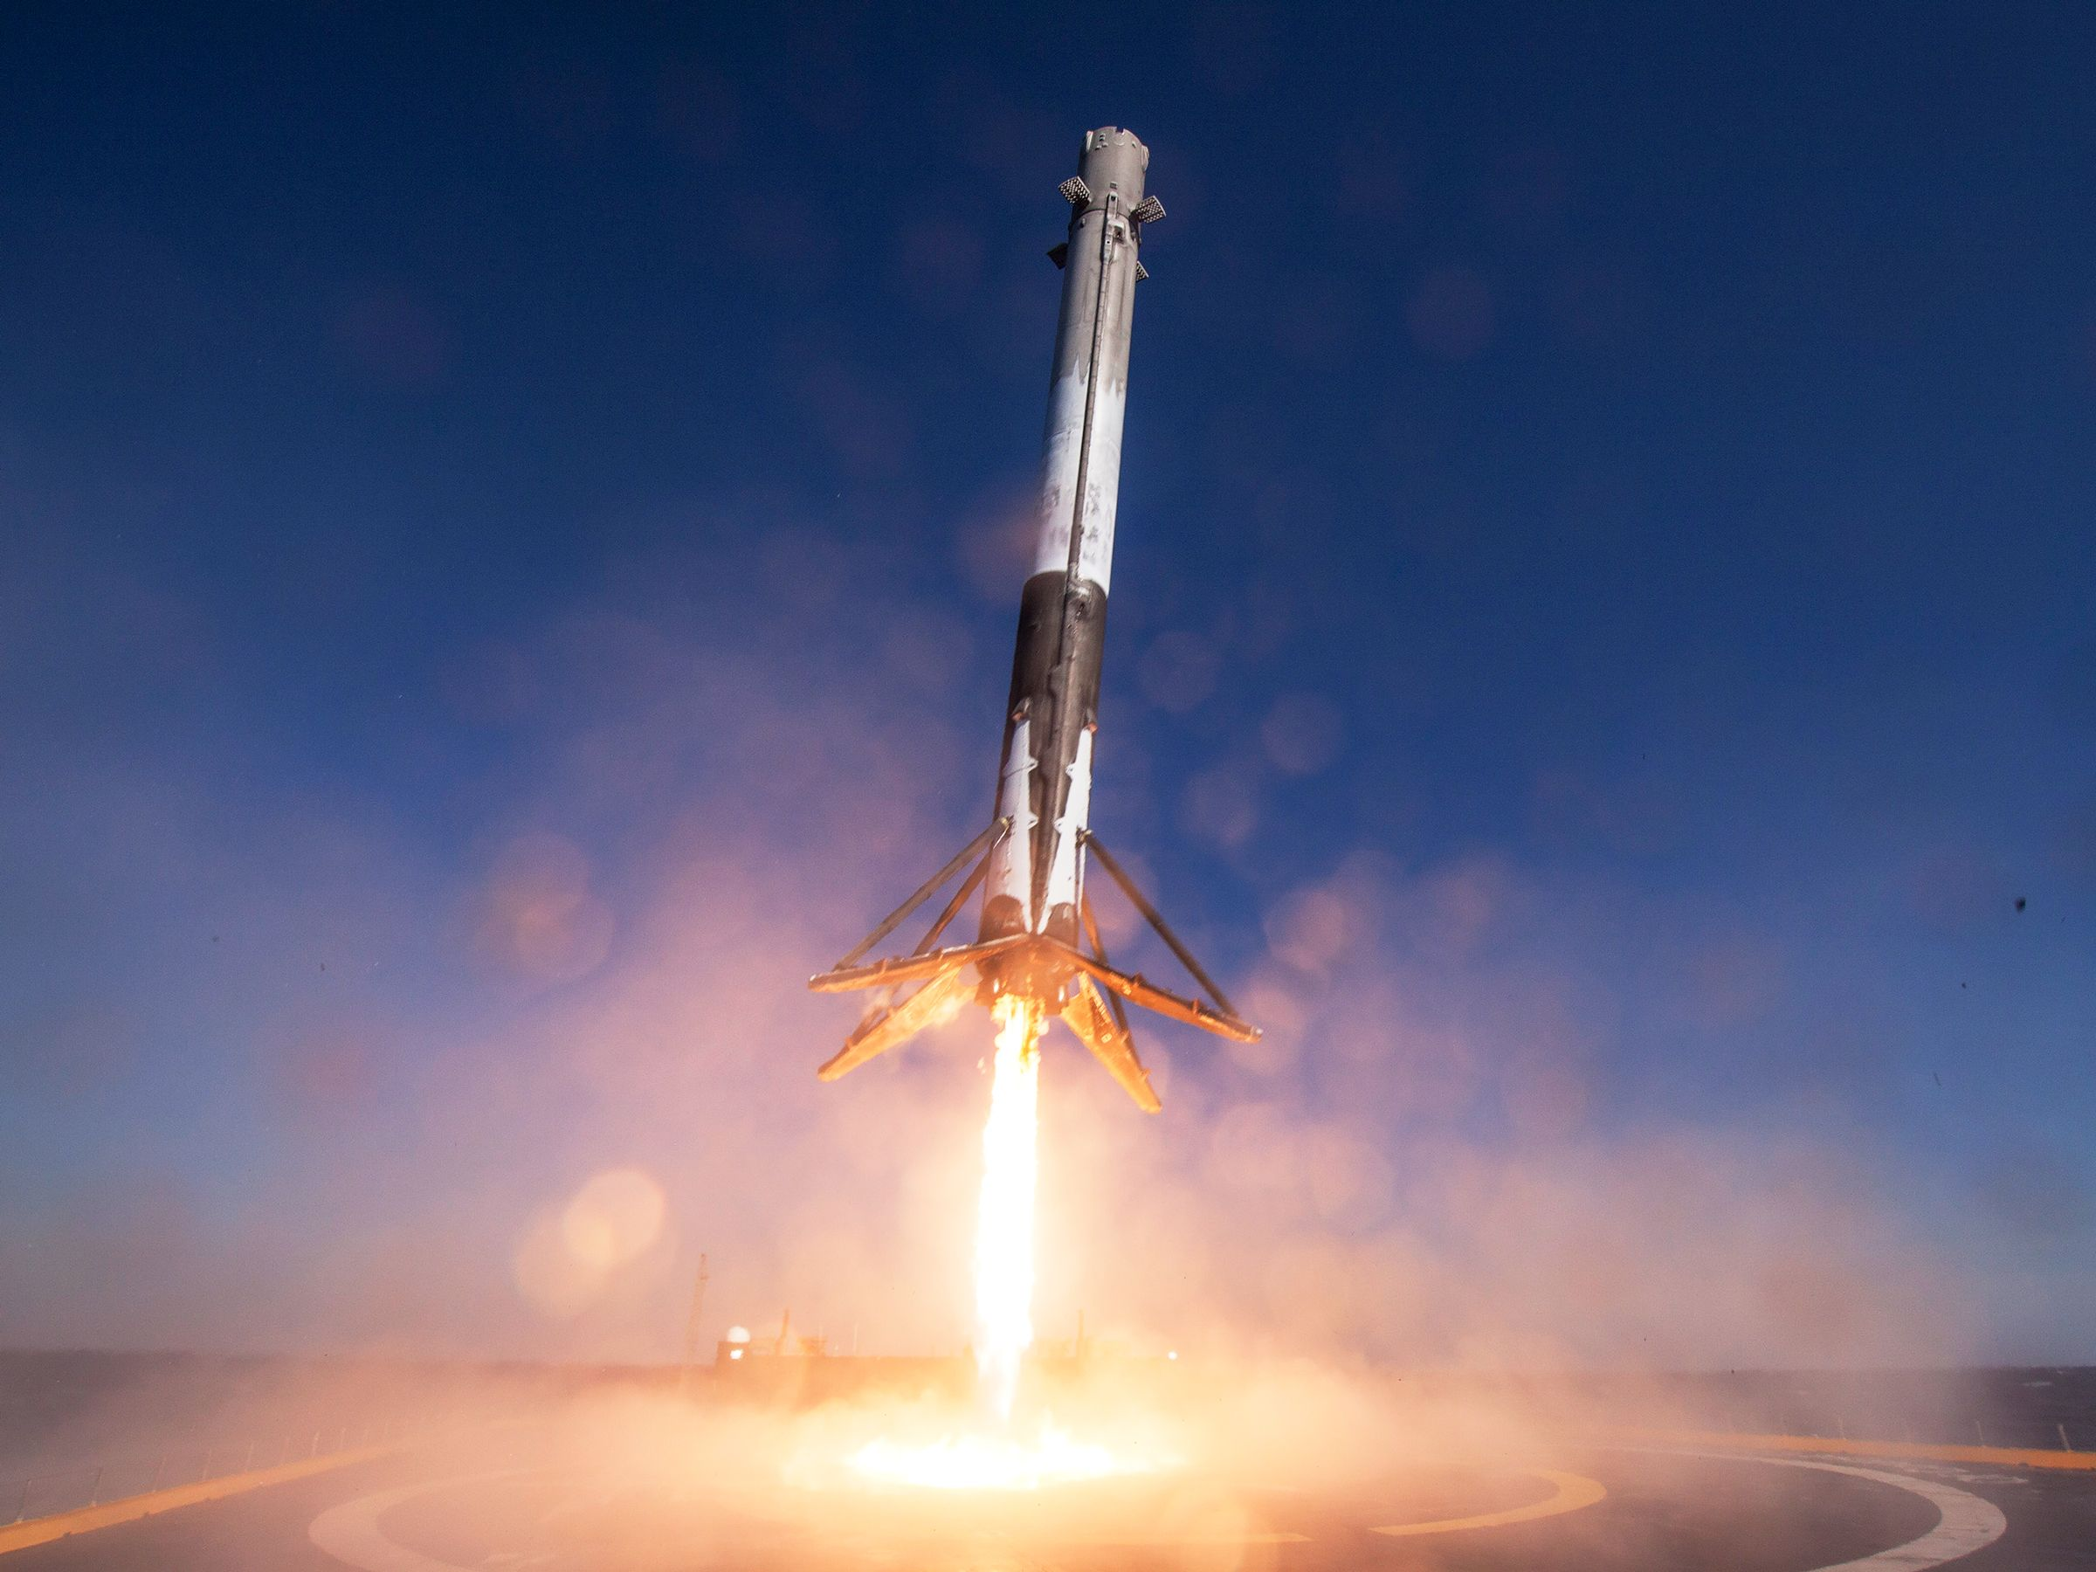
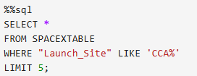
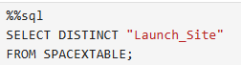

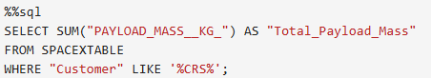
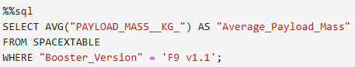
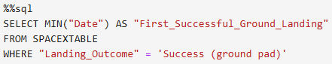
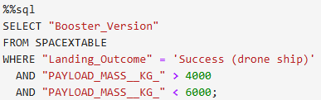
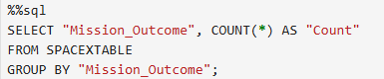
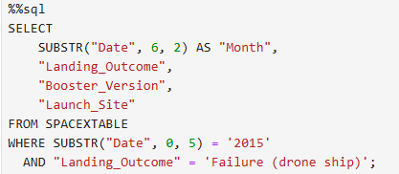
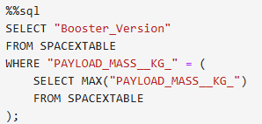
Notebook
Database
My Skills
Unique launch site
Launch sites with ‘CCA”
Total payload mass carried by boosters launched by NASA (CRS)
Average payload mass carried by booster version F9 v1.1
N E X T
Date when the first successful landing outcome
Names of boosters between 4 and 6K
Mission success
Analysis Using
SQL
Booster version

Slide 14
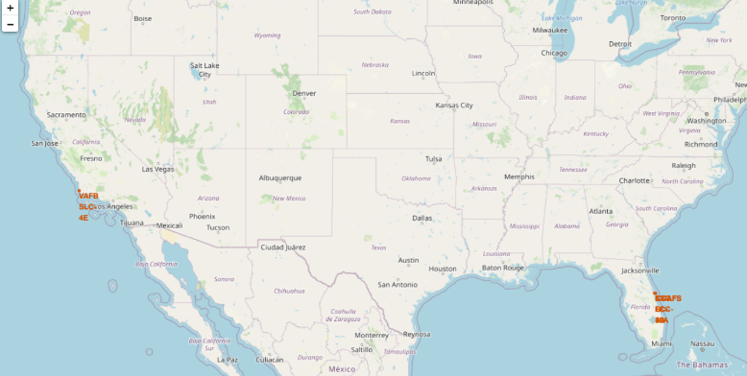
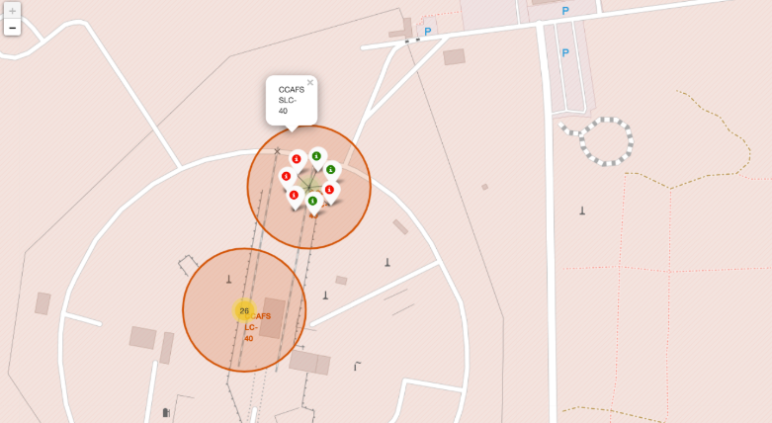
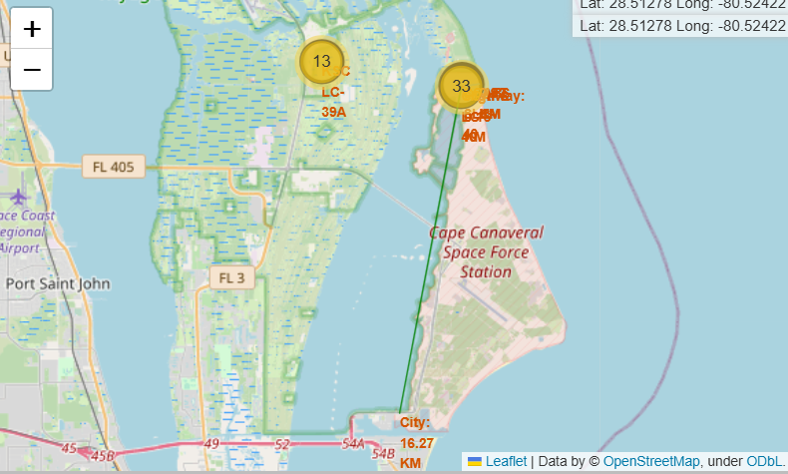
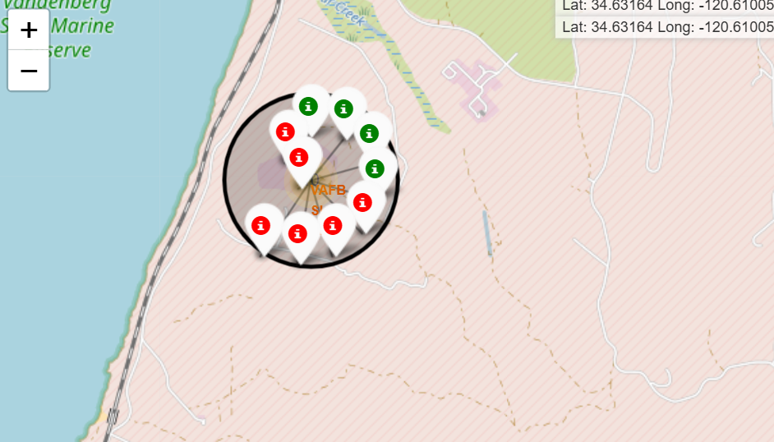
Site Location Mapping
Proximaty Analysis
Launch Success/Failure
N E X T
Notebook
Measuring Distances
Cluster Markers

Slide 15
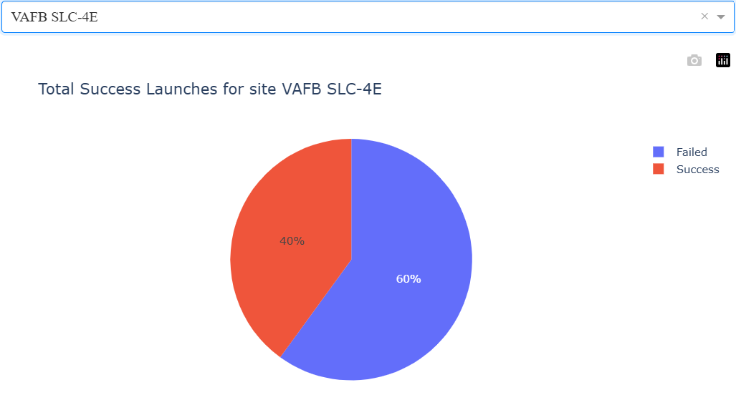
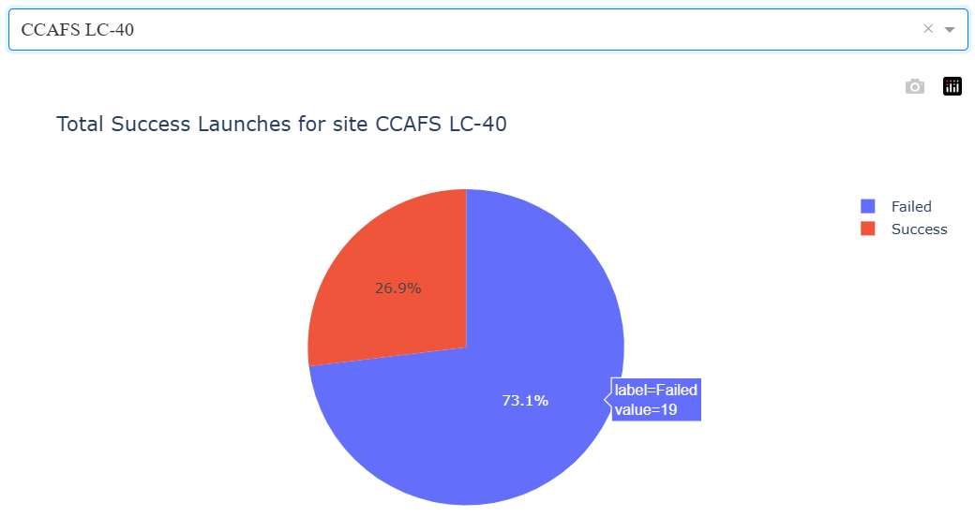
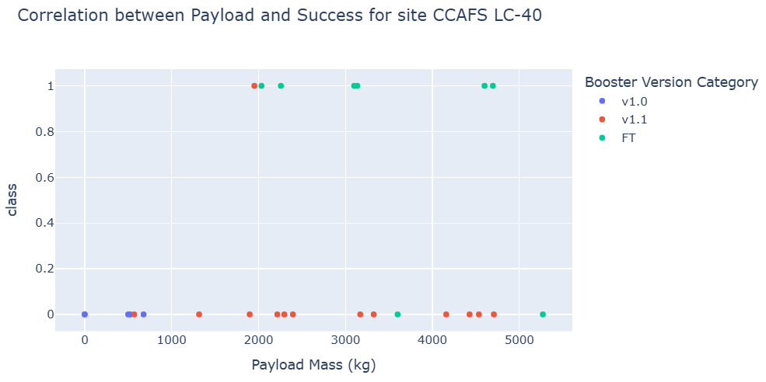
Real-time filtering capabilities
Dynamic success analysis
Launch site comparison
Python
Launch Sites Visualization: • Kennedy Space Center (KSC) - Florida • Cape Canaveral Air Force Station (CCAFS) - Florida • Vandenberg Air Force Base (VAFB) - California
Results Dashboard
VAFB SLC-4E
N E X T
CCAFS LC-40
Correlation: Payload and Success—CCAFS LC-40

Slide 16
Site Location Mapping
Proximaty Analysis
Launch Success/Failure
N E X T
Notebook
Measuring Distances
Cluster Markers

Slide 17

Logistic regression
Confusion Matrices
SVM
SVM
N E X T
Decision Tree
KNN

Slide 18
Predictive Analysis
Models Used
Logistic Regression
Support Vector Machine (SVM)
Decision Tree Classifier
K-Nearest Neighbors (KNN)
Input Features
Flight Number (experience proxy)
Payload Mass (kg)
Orbit Type (LEO, GTO, etc.)
Launch Site (encoded)
Grid Fins, Legs, Landing Pad
N E X T
Training Process
Data Split: 80% training, 20% testing
Preprocessing: StandardScaler for feature normalization
Optimization: GridSearchCV with 5-fold cross-validation
Evaluation: Accuracy, Precision, Recall, F1-Score, AUC-ROC

Slide 19
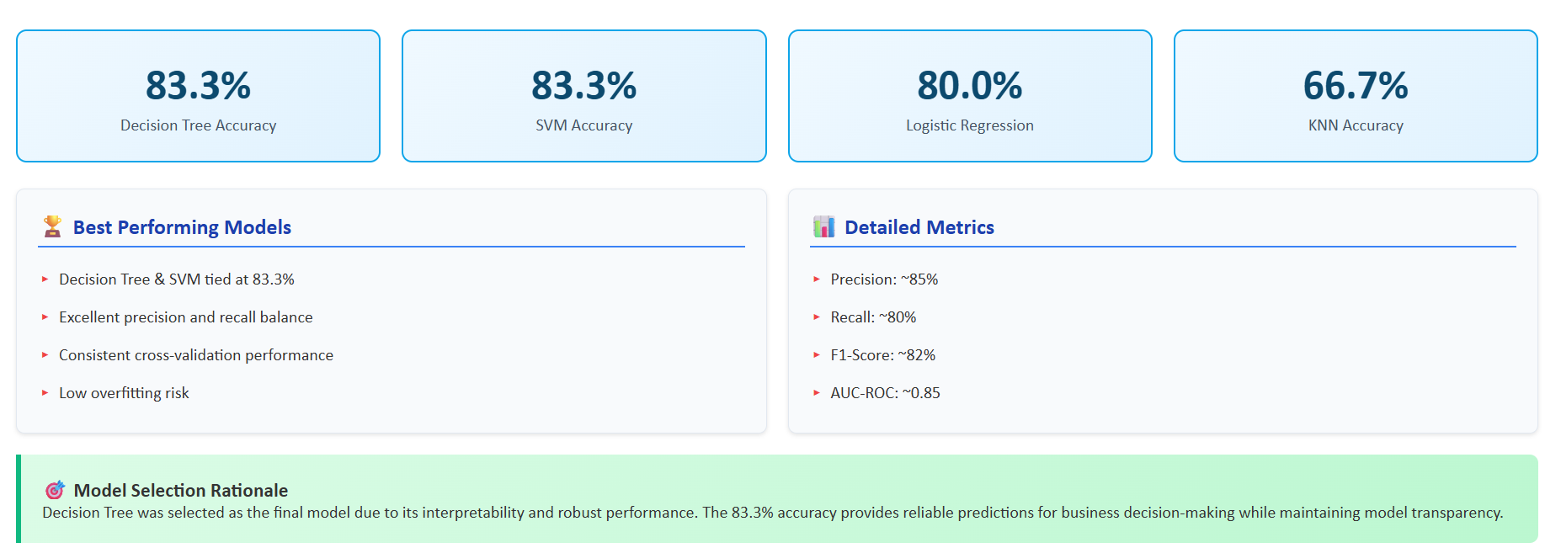
Model Performance
Results
Notebook
N E X T

Slide 20
Key Insights
Success Factors Identified
Experience matters: Success improves with flight number
Heavy payloads correlate with higher success rates
KSC LC-39A shows superior performance
LEO missions have different patterns than GTO
Temporal
Dramatic improvement from 2015-2020
Clear organizational learning curve
Recent missions achieve 80%+ success
Technology advancement visible in data
N E X T

Slide 21
Project Achievements
Technical Accomplishments
Developed predictive models with 83% accuracy
Comprehensive data collection & processing
Identified critical success factors
Created actionable business intelligence
Demonstrated complete data science methodology
Interactive visualizations & dashboards
Multiple ML model evaluation & optimization
Geospatial analysis with mapping
Conclusion
N E X T

Slide 22
Appendix
Data Collection (SpaceX API)
Notebook
Output Dataset
Web Scraping (Wikipedia)
Notebook
Output Dataset
Data Wrangling
Notebook
Output Dataset
Visualization
Notebook
Output Dataset
SQL
Notebook
Database
N E X T
Proximity Analysis
Notebook
Results Dashboard (Plotly Dash)
Python
Predictive Modeling
Notebook

